Slide 1

Demographic and Geographic
Determinants of Health
Bechir Bouzid, Will Dalton, Xin Yuen

Slide 2

Research Question
How is health impacted by
demographic and geographic factors
in the United States?
Notes:
The obesity epidemic is a growing public health concern that has been accompanied by a rise in chronic conditions such as diabetes and cardiovascular disease (Hurt et al., 2010).
Although obesity and chronic conditions have been on the rise across the country, researchers have found health disparities by race (e.g., White individuals have lower rates of obesity than do Black and Hispanic individuals; Wang & Beydoun, 2007)

Slide 3
Variables
Health
Multimorbidity of weight-related illnesses (e.g., heart disease, diabetes)
BMI (overweight = 25+)
Demographics
Race (Hispanic, Non-Hispanic Black & White)
Ability to afford fruits and vegetables
Geography
Supermarket access

Slide 4



Data sources
2014 Healthy Americas Survey
2014 Community
Health Status Indicators
2015 Food Access
Research Atlas
Project Link: https://github.com/FoolsArcana/ready_project_one
Notes:
846

Slide 5
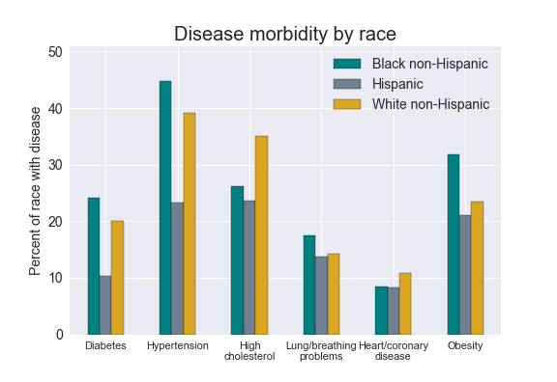
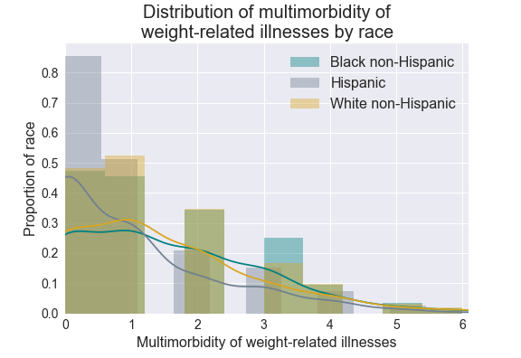
Weight-related illnesses x race

Slide 6
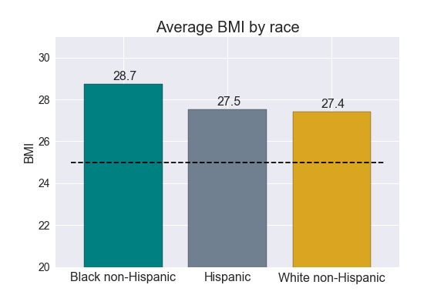
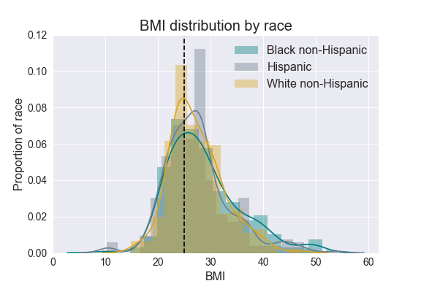
BMI x race

Slide 7
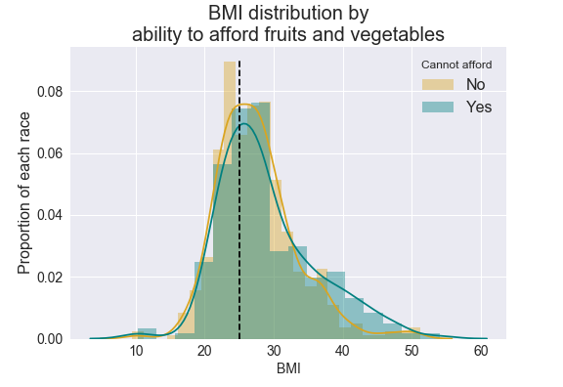
BMI x affordability of fruit/veg

Slide 8
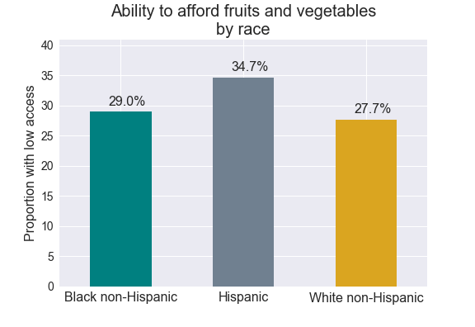
Affordability of fruit/veg x race

Slide 9
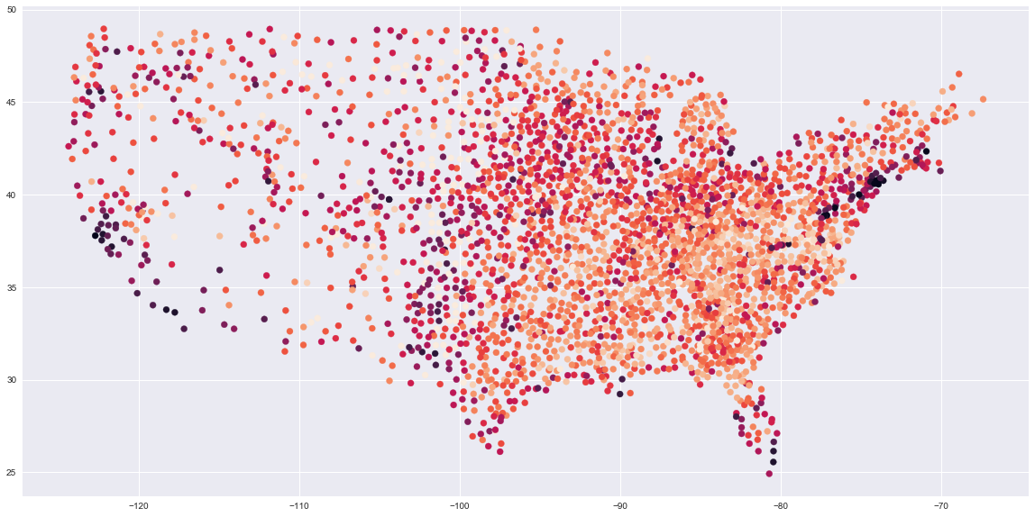
National food scarcity by county

Slide 10
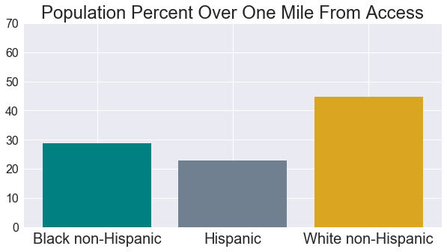
National food scarcity by race

Slide 11
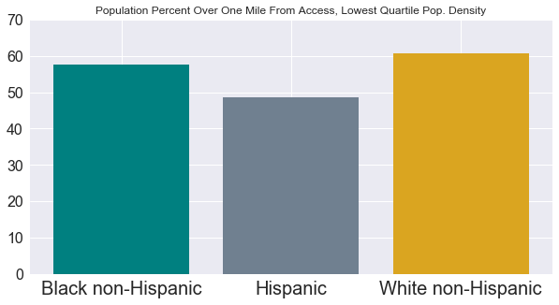
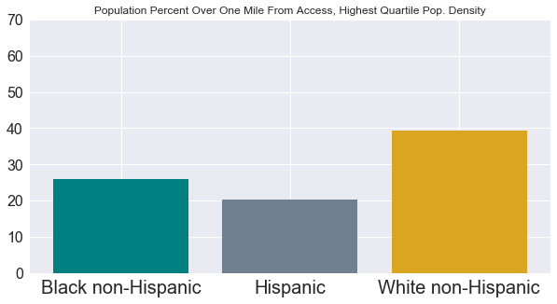
National food scarcity by race vs population density

Slide 12
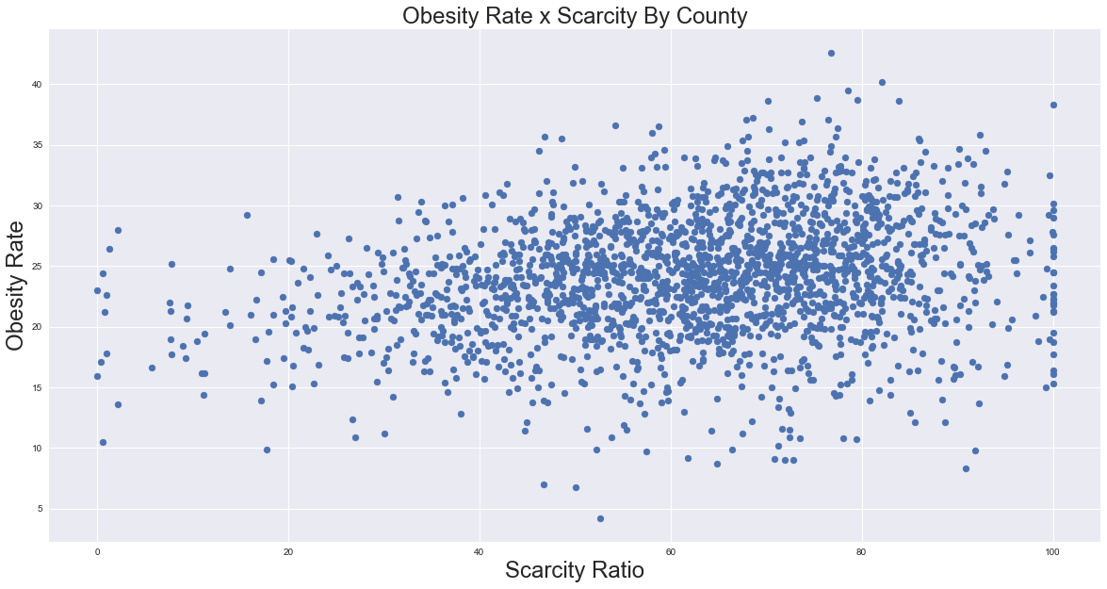
Obesity rates x food scarcity rates

Slide 13
Implications
Food scarcity is related to higher BMI and obesity rates at the national and individual level
Differs by race but inconsistent results at the national and individual level
Racial differences in BMI, obesity, and other weight-related illnesses
However, cannot fully be explained by lack of access

Slide 14
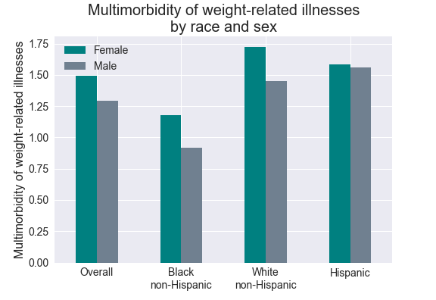
Weight-related illnesses x race & sex

